Slide 1
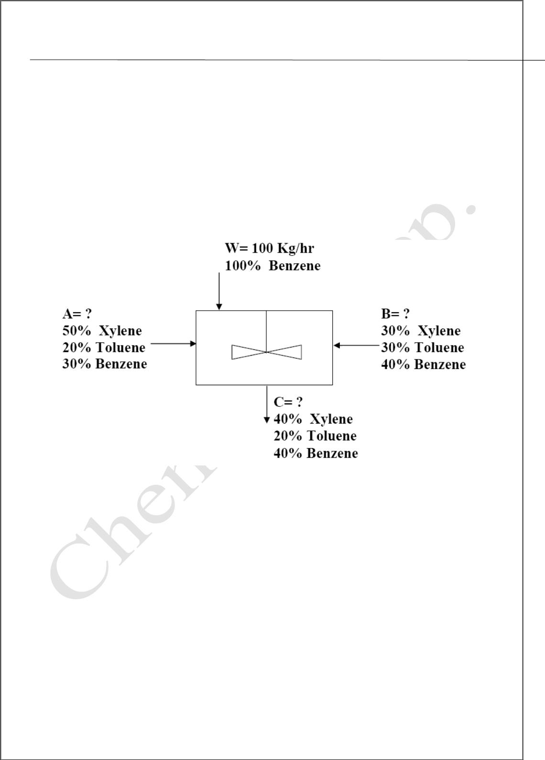
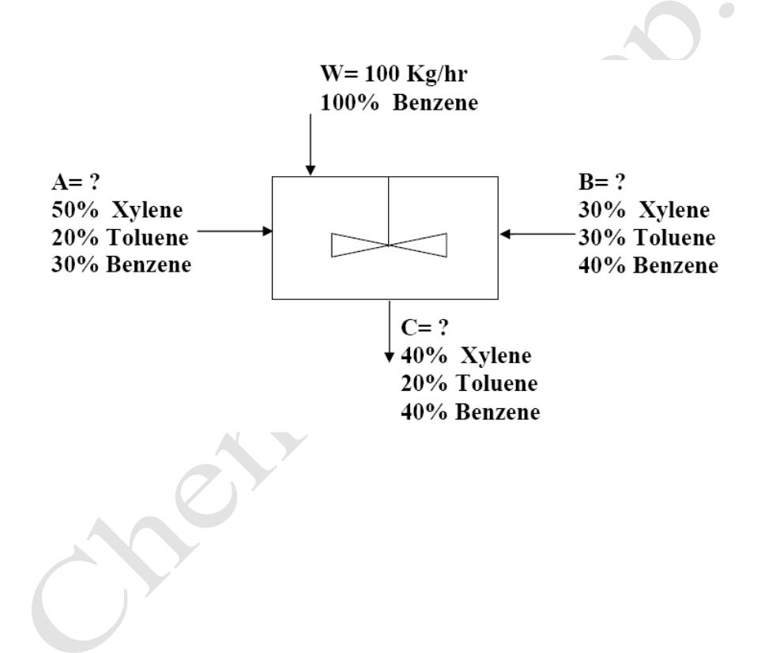
Lecturer
MatLab
Diyala university / College of Engineering
Omar A. Imran
Department of Chemical Eng.
Second Class
2019 – 2020
Limits at infinity:
>>limit(exp(-x^2-5)+3, x, Inf)
ans =
3
Exercise 1:
For the mixer shown below write a code to find the values of streams A, B and C?
Trail Version
Trail Version
Trail Version
Trail Version
Trail Version
Trail Version
Trail Version
Trail Version
Trail Version
Trail Version
Trail Version
Trail Version
Trail Version
Solution: By making component material balance on each component within the
mixer you can reach to a system of three equations which can be solve by using
the
command solve to find the unknowns A, B, C.
Type the following command:
[A,B,C]=solve('.5*A+.3*B=.4*C','.2*A+.3*B=.2*C','.3*A+.4*B+100=.4*C')
The results will be:
A =
600
B =
200
31

Slide 2
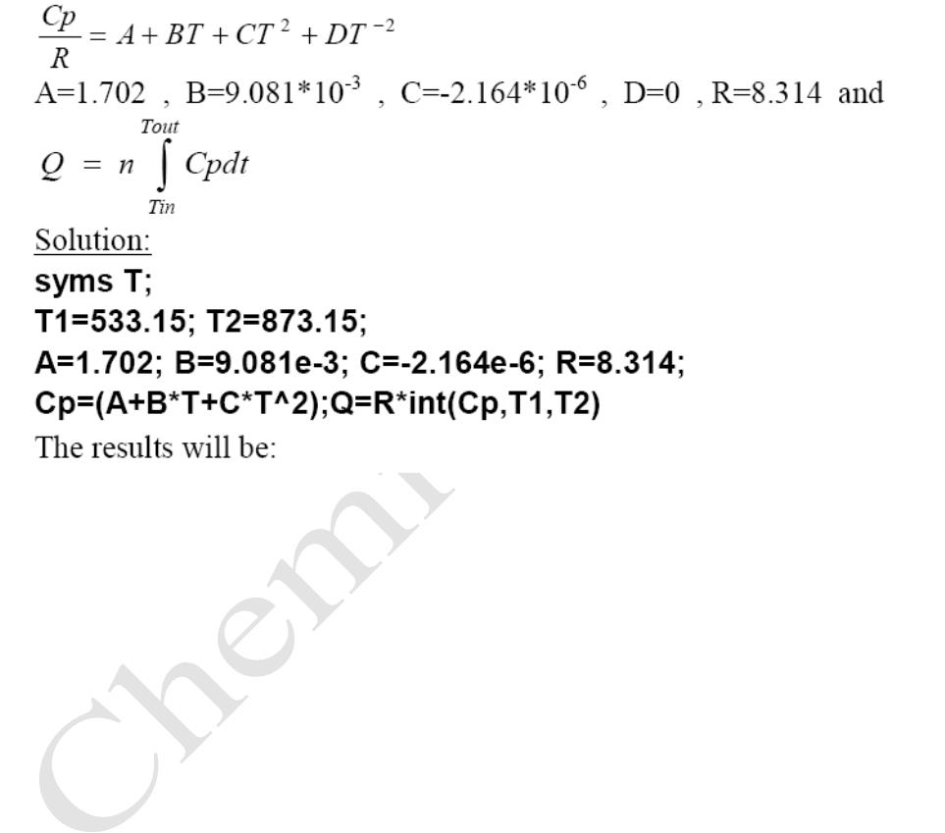
Lecturer
MatLab
Diyala university / College of Engineering
Omar A. Imran
Department of Chemical Eng.
Second Class
2019 – 2020
C =
900
Exercise 3:
Calculate the heat required to increase the temperature of 1 mol of methane from
533.15 K to 873.15 C at a pressure approximately 1 bar. Where
Trail Version
Trail Version
Trail Version
Trail Version
Trail Version
Trail Version
Trail Version
Trail Version
Trail Version
Trail Version
Trail Version
Trail Version
Trail Version
Q=
1.9778e+004
32

Slide 3
Lecturer
MatLab
Diyala university / College of Engineering
Omar A. Imran
Department of Chemical Eng.
Second Class
2019 – 2020
1.1INPUT Prompt for user input.
R = INPUT('How many apples') gives the user the prompt in the text string and then
waits for input from the keyboard. The input can be any MATLAB expression, which is
evaluated, using the variables in the current workspace, and the result returned in R. If
the user presses the return key without entering anything, INPUT returns an empty
matrix.
R = INPUT('What is your name','s') gives the prompt in the text string and waits for
character string input. The typed input is not evaluated; the characters are simply
returned as a MATLAB string.
a=input('a=')
b=input('b=')
c1=a*b
c2= a/b
c3=a+b
Trail Version
Trail Version
Trail Version
Trail Version
Trail Version
Trail Version
Trail Version
Trail Version
Trail Version
Trail Version
Trail Version
Trail Version
Trail Version
c4=a-b
c5=a^b
a=input('whats your name', 's')
a=
ali
33

Slide 4
Lecturer
MatLab
Diyala university / College of Engineering
Omar A. Imran
Department of Chemical Eng.
Second Class
2019 – 2020
Control Flow and operators
Introduction
MATLAB is also a programming language. Like other computer programming
languages, MATLAB has some decision making structures for control of command
execution. These decision making or control flow structures include for loops, while
loops, and if-else-end constructions. Control flow structures are often used in script M-
files and function M-files. By creating a file with the extension .m, we can easily write
and run programs. We do not need to compile the program since MATLAB is an
interpretative (not compiled) language. MATLAB has thou and of functions, and you can
add your own using m-files. MATLAB provides several tools that can be used to control
the flow of a program (script or function). In a simple program as shown in the previous
Chapter, the commands are executed one after the other. Here we introduce the flow
control structure that make possible to skip commands or to execute special group of
commands.
Control Flow
Trail Version
Trail Version
Trail Version
Trail Version
Trail Version
Trail Version
Trail Version
Trail Version
Trail Version
Trail Version
Trail Version
Trail Version
Trail Version
MATLAB has four control flow structures: the if statement, the for loop, the while loop,
and the switch statement.
1. If Statement
What are you doing if you want certain parts of your program to be executed only in
limited circumstances. The way to do that is by putting the code within an "if" statement.
The
most basic structure for "if" statement is as following:
if (relation)
(matlab commands)
end
More complicated structures are also possible including combinations like the following:
• if ... end
• if ... else ... end
• if ... else if ... else ... end end
34

Slide 5
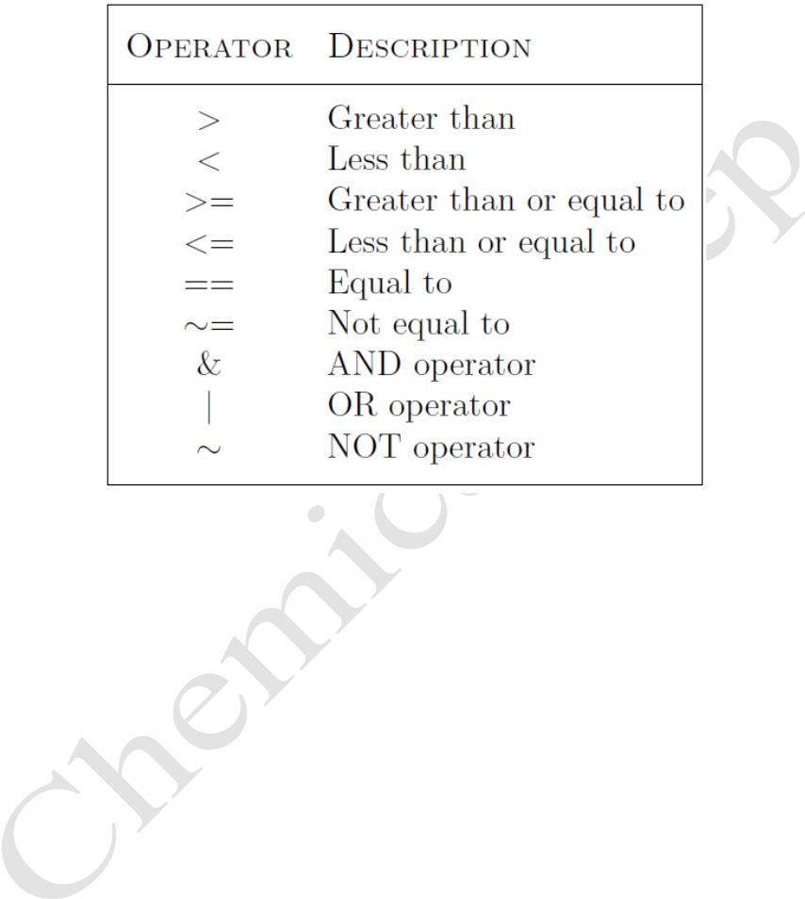
Lecturer
MatLab
Diyala university / College of Engineering
Omar A. Imran
Department of Chemical Eng.
Second Class
2019 – 2020
2-Relational and logical operators
A relational operator compares two numbers by determining whether a comparison is true
or false. Relational operators are shown in Table 5.1.
Table 5.1: Relational and logical operators
Trail Version
Trail Version
Trail Version
Trail Version
Trail Version
Trail Version
Trail Version
Trail Version
Trail Version
Trail Version
Trail Version
Trail Version
Trail Version
For example 1
a = 10;
b = 15;
if a<b
c= a^2
end
Example 2
a=input('a=')
b=input('b=')
if a<b
c1=a*b
c2= a/b
c3=a+b
c4=a-b
c5=a^b
end
disp('a more than b')
35

